Slide 1
Review for Unit 1 Test
Chapters 1, 2, 3, and 4

Slide 2
Science?
What is it?
Can it answer everything?
Two types?

Slide 3
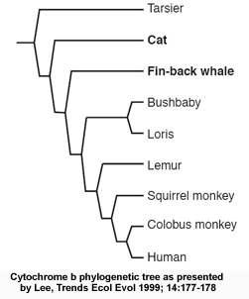

Slide 4
CHAPTER 2
Chemistry

Slide 5
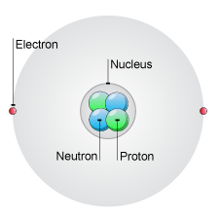

Slide 6
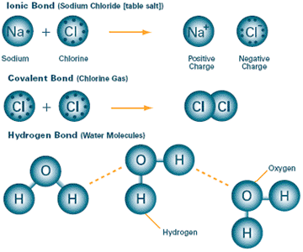

Slide 7
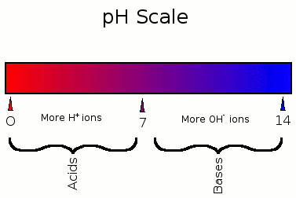
Buffer?

Slide 8
Chapter 3
Organic Compounds

Slide 9
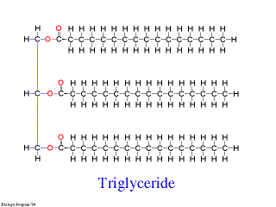
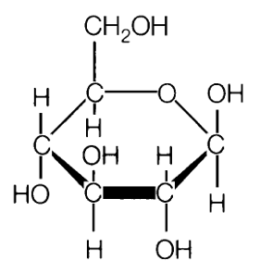
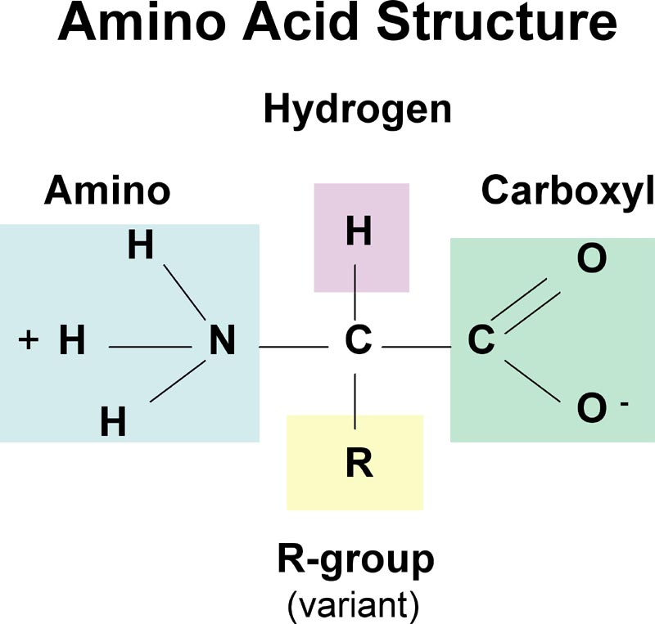
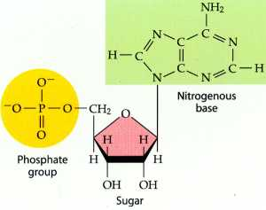

Slide 10
Chapter 4
Cell Structure

Slide 11
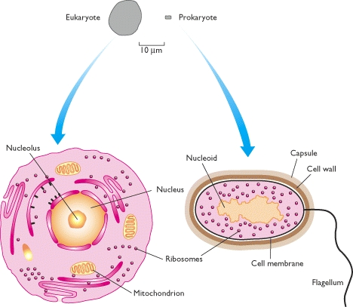
Eukaryote vs Prokaryote

Slide 13
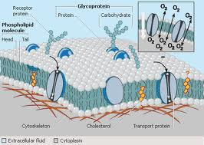

Slide 14
